Slide 1
Protecting Soybean Farmers from a scaling trade war
Jose Montes de Oca
Available: https://github.com/josber86/soybeananalysis

Slide 2
What is of supreme importance in war is to attack the enemy's strategy – Sun Tzu in the Art of War
How did we get here? Understandings China’s Soy Consumption
Are we there yet? Is there evidence of a slowdown?
What can we do to protect Americans heartland?
Recommendations to protect US Soy Producers

Slide 3
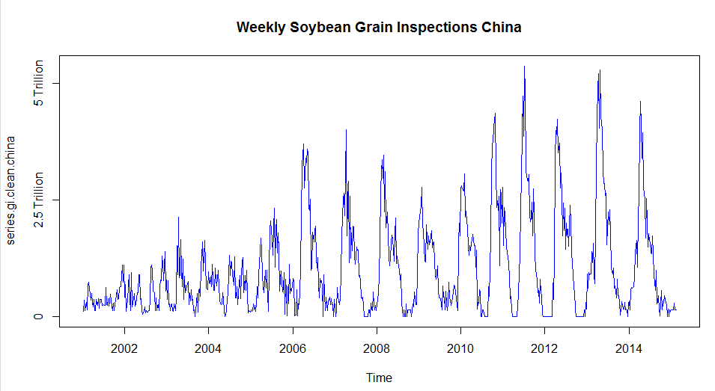
Is there a slowdown? A seasonal approach
Data: Federal Grain Inspection Services Yearly Export Grain https://fgisonline.ams.usda.gov/ExportGrainReport/
Objective: Are we already being affected
Outcome: a seasonal adjusted downward trend exists using 2010 – 2018 Data

Slide 4
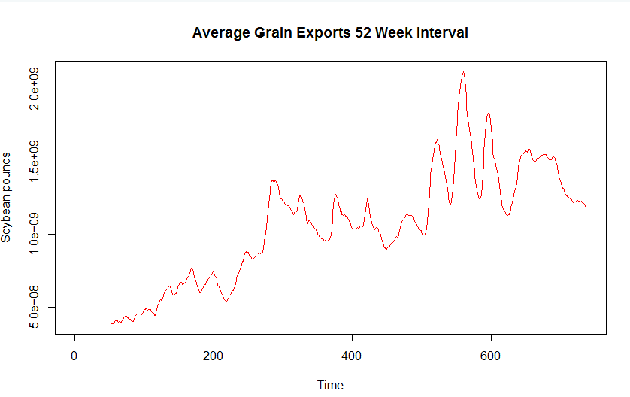
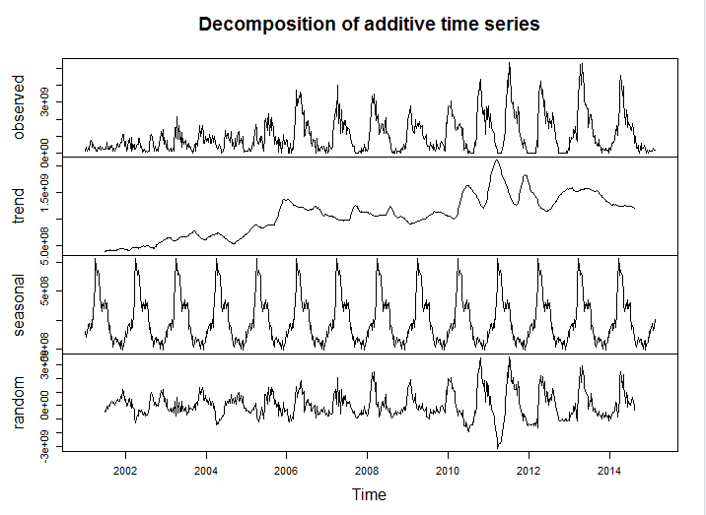
Is there a slowdown? A seasonal approach
52 Week interval really shows a trend
Analysis using package TTR confirms this:

Slide 5
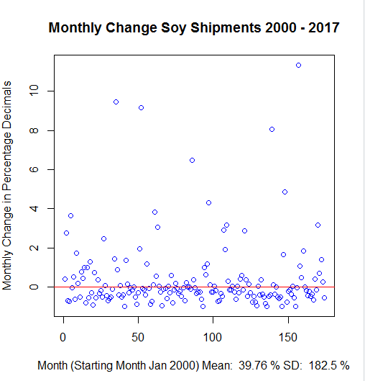
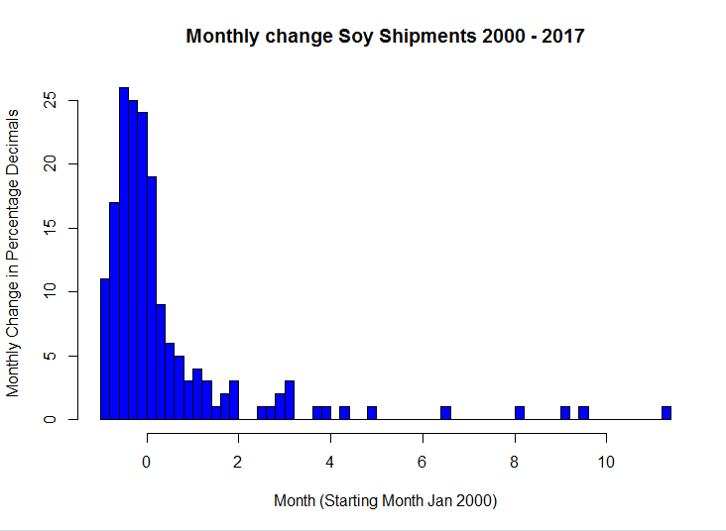
Hypothesis Testing
Data: Federal Grain Inspection Services Yearly Export Grain https://fgisonline.ams.usda.gov/ExportGrainReport/ monthly.change.2000.2018$MonthlyChangeTrend
High Kurtosis and Skewess

Slide 6
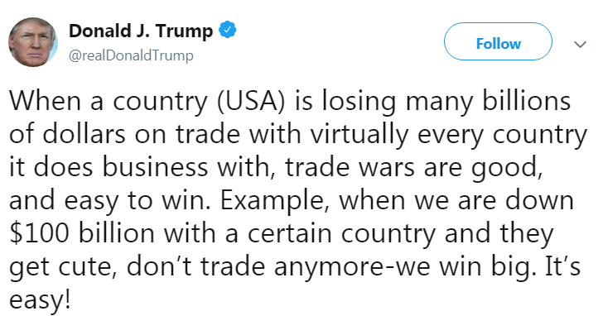
Hypothesis Testing
Hypothesis Testing. Did the Growth Rate change from last 8 months from historical average? Tweet in March
Null Hypothesis: μ = 0.3976
Alternative Hypothesis: μ ≠ 0.3976
Sample size = 9
Using a t-Test: t = (-.0565 – 0.3976) / (.9194)/ √9 = -1.481727
Probability df =8 t = +/- 2.306 alpha = .05
We fail to reject the Null so we see no signs of slowdown yet. So we must prepare!
Notice we reject at df =8 t = +/- 1.397 alpha = .2
 | Pounds | Percentage Change
March | 2,604,039,287 | -0.5114
April | 1,041,076,780 | -0.6002
May | 1,464,366,808 | 0.4066
June | 454,315,030 | -0.6898
July | 274,029,100 | -0.3968
August | 426,771,130 | 0.5574
September | 147,609,262 | -0.6541
October | 449,682,660 | 2.0464
November | 149,910,560 | -0.6666
 | Average | -0.0565
 | Standard Deviation | 0.9194
 | Sample Size | 9

Slide 7
What drives Soy Export from US to China?
Regression Analysis using 2000-2015 Data:
EXPORTSUSTOCHINA: independent variable, United States Department of Agriculture, Soybean export to China from the US.
EXPORTTOTALUS: dependent variable, US Department of Agriculture; Economic Research Service, U.S. soybean exports from 1999 to 2015 (in 1,000 bushels)
GAS: dependent variable, Energy Information Administration, Retail price of regular gasoline in the United States from 1990 to 2017 (in U.S. dollars per gallon)*
USTOTALPROD: dependent variable, US Department of Agriculture; National Agricultural Statistics Service, Production of soybeans in the U.S. from 2000 to 2017 (in 1,000 bushels)
PHDI: dependent variable, NOAA, Annual amount of precipitation in the United States from 1895 to 2017 (in inches)
FOREX: dependent variable, Dollar Yuan Exchange Rate - 35 Year Historical Chart, macrotrends.net
CHINASOYEXPORTOWORLD: dependent variable, China Import-Exports 2000-2015, Center for International Development at Harvard University, http://atlas.cid.harvard.edu/data

Slide 8
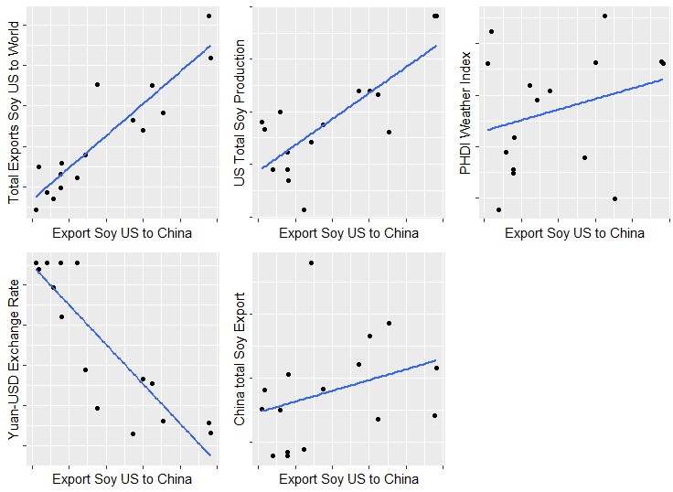
Regression Model Evaluation
Maybe we need to exclude one of US Total Soy Production or Total Exports Soy US to the World. Given: Total Exports Soy US to the World Correlation with US Total Soy Production (.76) and Yuan-USD Exchange Rate (-.69) we need to exclude Total Exports Soy US to the World

Slide 9
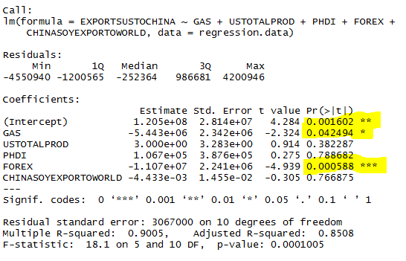
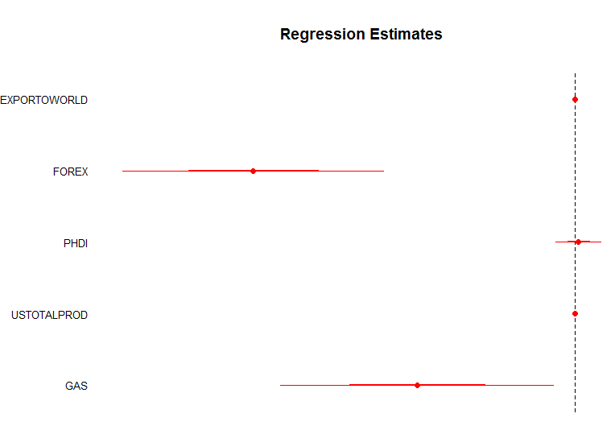
Regression findings
Regression Results
Only GAS and FOREX are significant
Residuals seem random

Slide 10
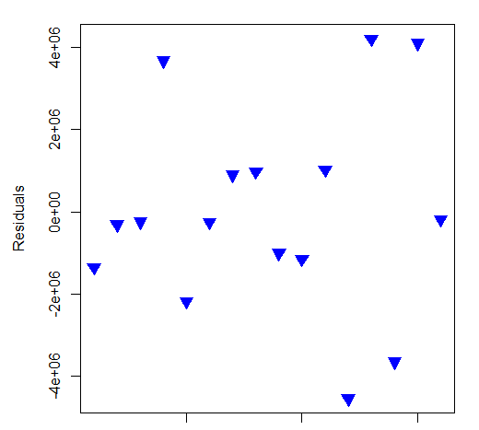
Regression findings (cont.)

Slide 11
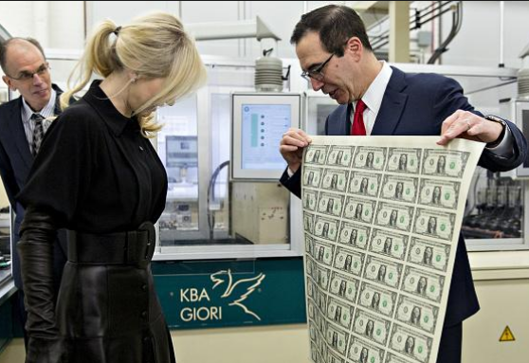
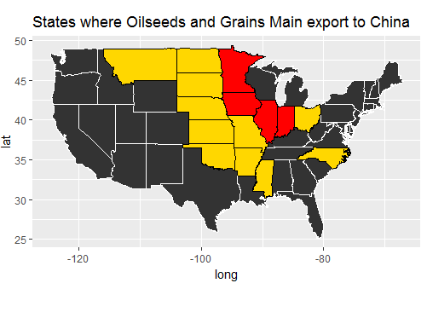
Policy Recommendations
At the Macro Level – Depress the value of the Dollar (print, print, print)
At the Micro Level – subsidies tied to Gas Prices or increase domestic soy consumption (bio fuel, increase meat consumption, or meat exports)
State | Commodity
Illinois | 1. Oilseeds & Grains - $2.1 billion
Iowa | 1. Oilseeds & Grains - $1.8 billion
Indiana | 1. Oilseeds & Grains - $1.2 billion
Minnesota | 1. Oilseeds & Grains - $1.2 billion
Nebraska | 1. Oilseeds & Grains - $1.1 billion
Montana | 1. Oilseeds & Grains - $110 million
North Carolina | 1. Oilseeds & Grains - $234 million
Mississippi | 1. Oilseeds & Grains - $423 million
Arkansas | 1. Oilseeds & Grains - $571 million
Oklahoma | 1. Oilseeds & Grains - $73 million
Kansas | 1. Oilseeds & Grains - $767 million
North Dakota | 1. Oilseeds & Grains - $818 million
South Dakota | 1. Oilseeds & Grains - $826 million
Missouri | 1. Oilseeds & Grains - $885 million
Ohio | 1. Oilseeds & Grains - $898 million

